Slide 1
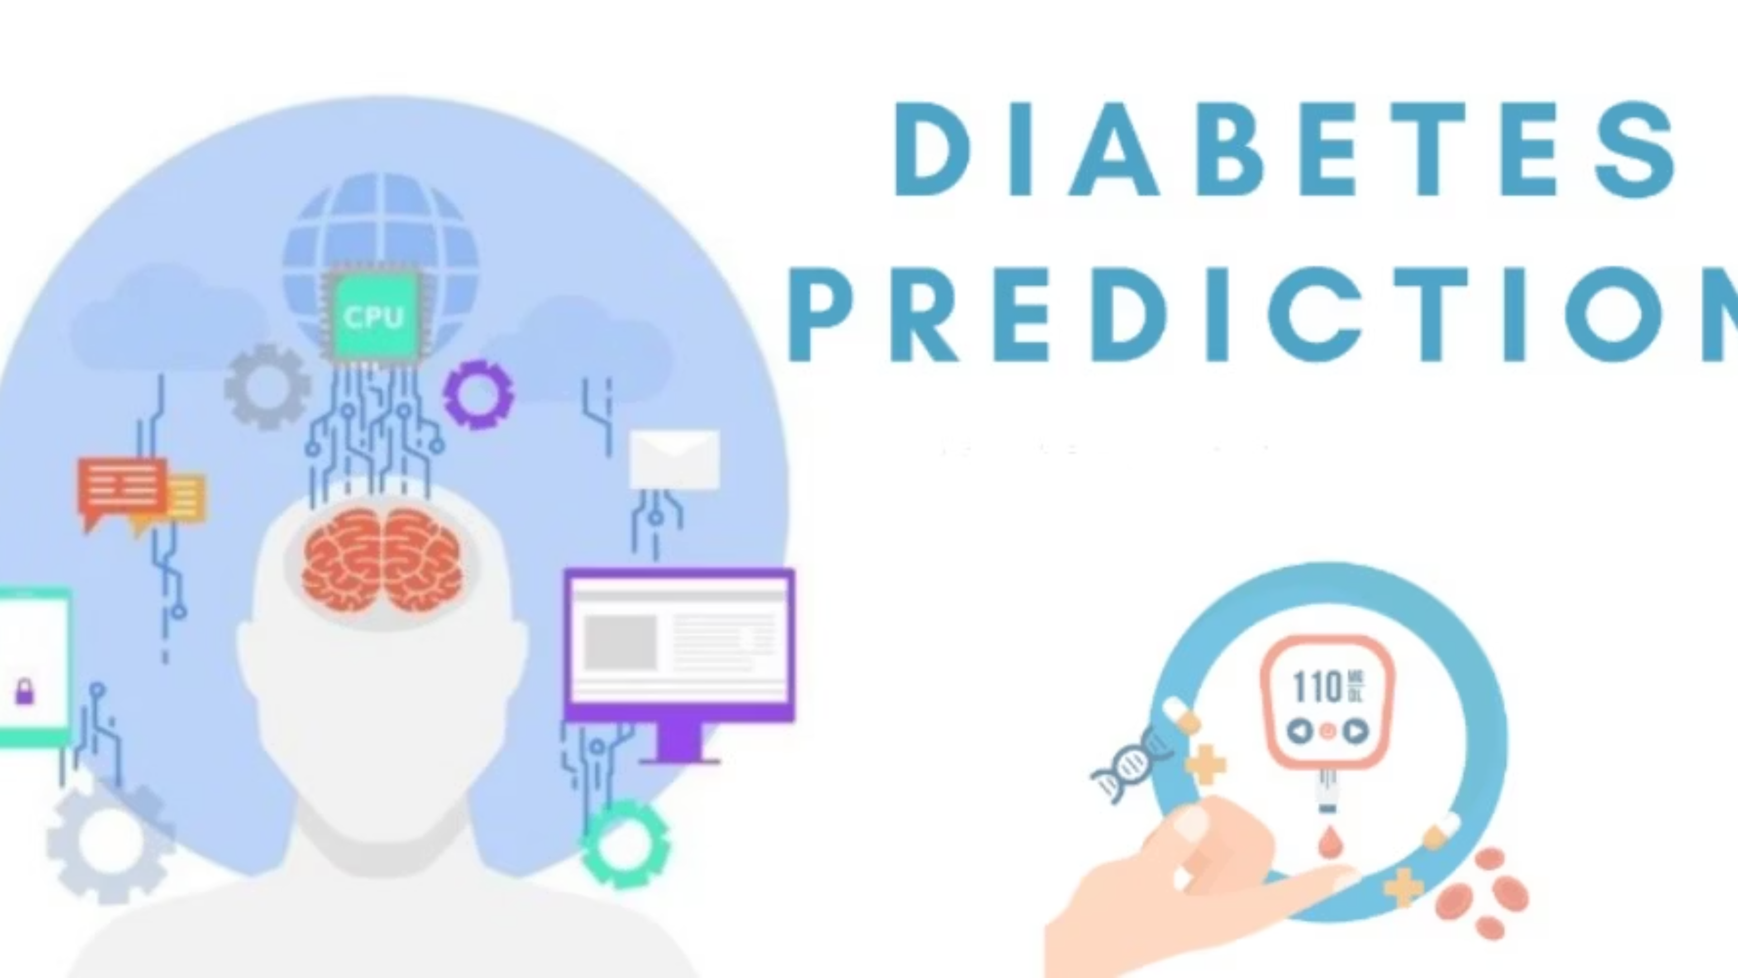
Understanding Diabetes & Introducing Our Diabetes Risk Checker.
Welcome to our presentation on diabetes, a pervasive health challenge affecting millions globally. We'll demystify this condition, explore its causes, and discuss crucial detection methods. Following this, we're excited to introduce our innovative app, designed to empower you with early diabetes risk assessment.

Slide 2

What is Diabetes?
Diabetes is a chronic condition where your body struggles to regulate blood sugar (glucose) levels. This can happen if your body doesn't produce enough insulin, or if it can't effectively use the insulin it does produce.
There are two main types: Type 1 (an autoimmune condition) and Type 2 (often related to lifestyle factors).
Alarmingly, over 37 million Americans currently live with diabetes, and 1 in 3 adults have prediabetes without even knowing it (CDC, 2025).

Slide 3
Why Does Diabetes Happen? The Main Causes
Underlying Mechanisms
Key Risk Factors
Type 1 Diabetes: The immune system mistakenly attacks and destroys the insulin-producing cells in the pancreas.
Obesity: A significant contributor, especially to Type 2 diabetes.
Type 2 Diabetes: The body either becomes resistant to the effects of insulin (insulin resistance) or doesn’t produce enough insulin to maintain normal glucose levels.
Sedentary Lifestyle: Lack of physical activity increases risk.
Poor Diet: High intake of processed foods, sugar, and unhealthy fats.
Family History: Genetics play a role in both types.
Age: Risk increases significantly after age 45.
Understanding these factors is crucial for prevention and early intervention.

Slide 4
The Challenge: Millions Are Undiagnosed
Approximately 1 in 3 people living with diabetes are unaware they have the condition. This staggering statistic highlights a critical gap in public health.
Early detection is paramount. Identifying diabetes in its initial stages allows for timely intervention, significantly reducing the risk of severe complications such as:
However, several barriers often prevent individuals from seeking diagnosis:
Cost: Financial concerns related to testing and consultations.
Heart disease and stroke
Kidney failure
Clinic Access: Limited availability of healthcare facilities, especially in underserved areas.
Vision loss and blindness
Nerve damage
Fear of Needles: Anxiety or discomfort associated with traditional blood draws.
These challenges underscore the need for accessible, non-invasive screening solutions.

Slide 5
Problem Statement
Diabetes is increasing rapidly across the world.
Early detection is very important to reduce complications.
Traditional medical diagnosis can be time-consuming.
We need a predictive model that helps in early identification using patient data.

Slide 6

Pima Indians Diabetes Dataset
Our Diabetes Risk Checker App leverages insights from the well-regarded Pima Indians Diabetes Dataset, a crucial resource in medical research. This dataset is instrumental in training our predictive model to accurately assess diabetes risk.
It comprises a collection of health metrics from female patients, offering a comprehensive view of various factors linked to diabetes onset:
Pregnancies: Number of times pregnant.
Glucose Level: Plasma glucose concentration (2 hours in an oral glucose tolerance test).
Blood Pressure: Diastolic blood pressure (mm Hg).
Skin Thickness: Triceps skin fold thickness (mm).
Insulin: 2-Hour serum insulin (mu U/ml).
BMI: Body Mass Index (weight in kg / (height in m)^2).
Diabetes Pedigree Function: A function that scores the likelihood of diabetes based on family history.
Age: Age in years.
The Outcome is the target variable, indicating whether the patient has diabetes (1) or not (0), allowing our model to learn patterns for risk prediction.

Slide 7
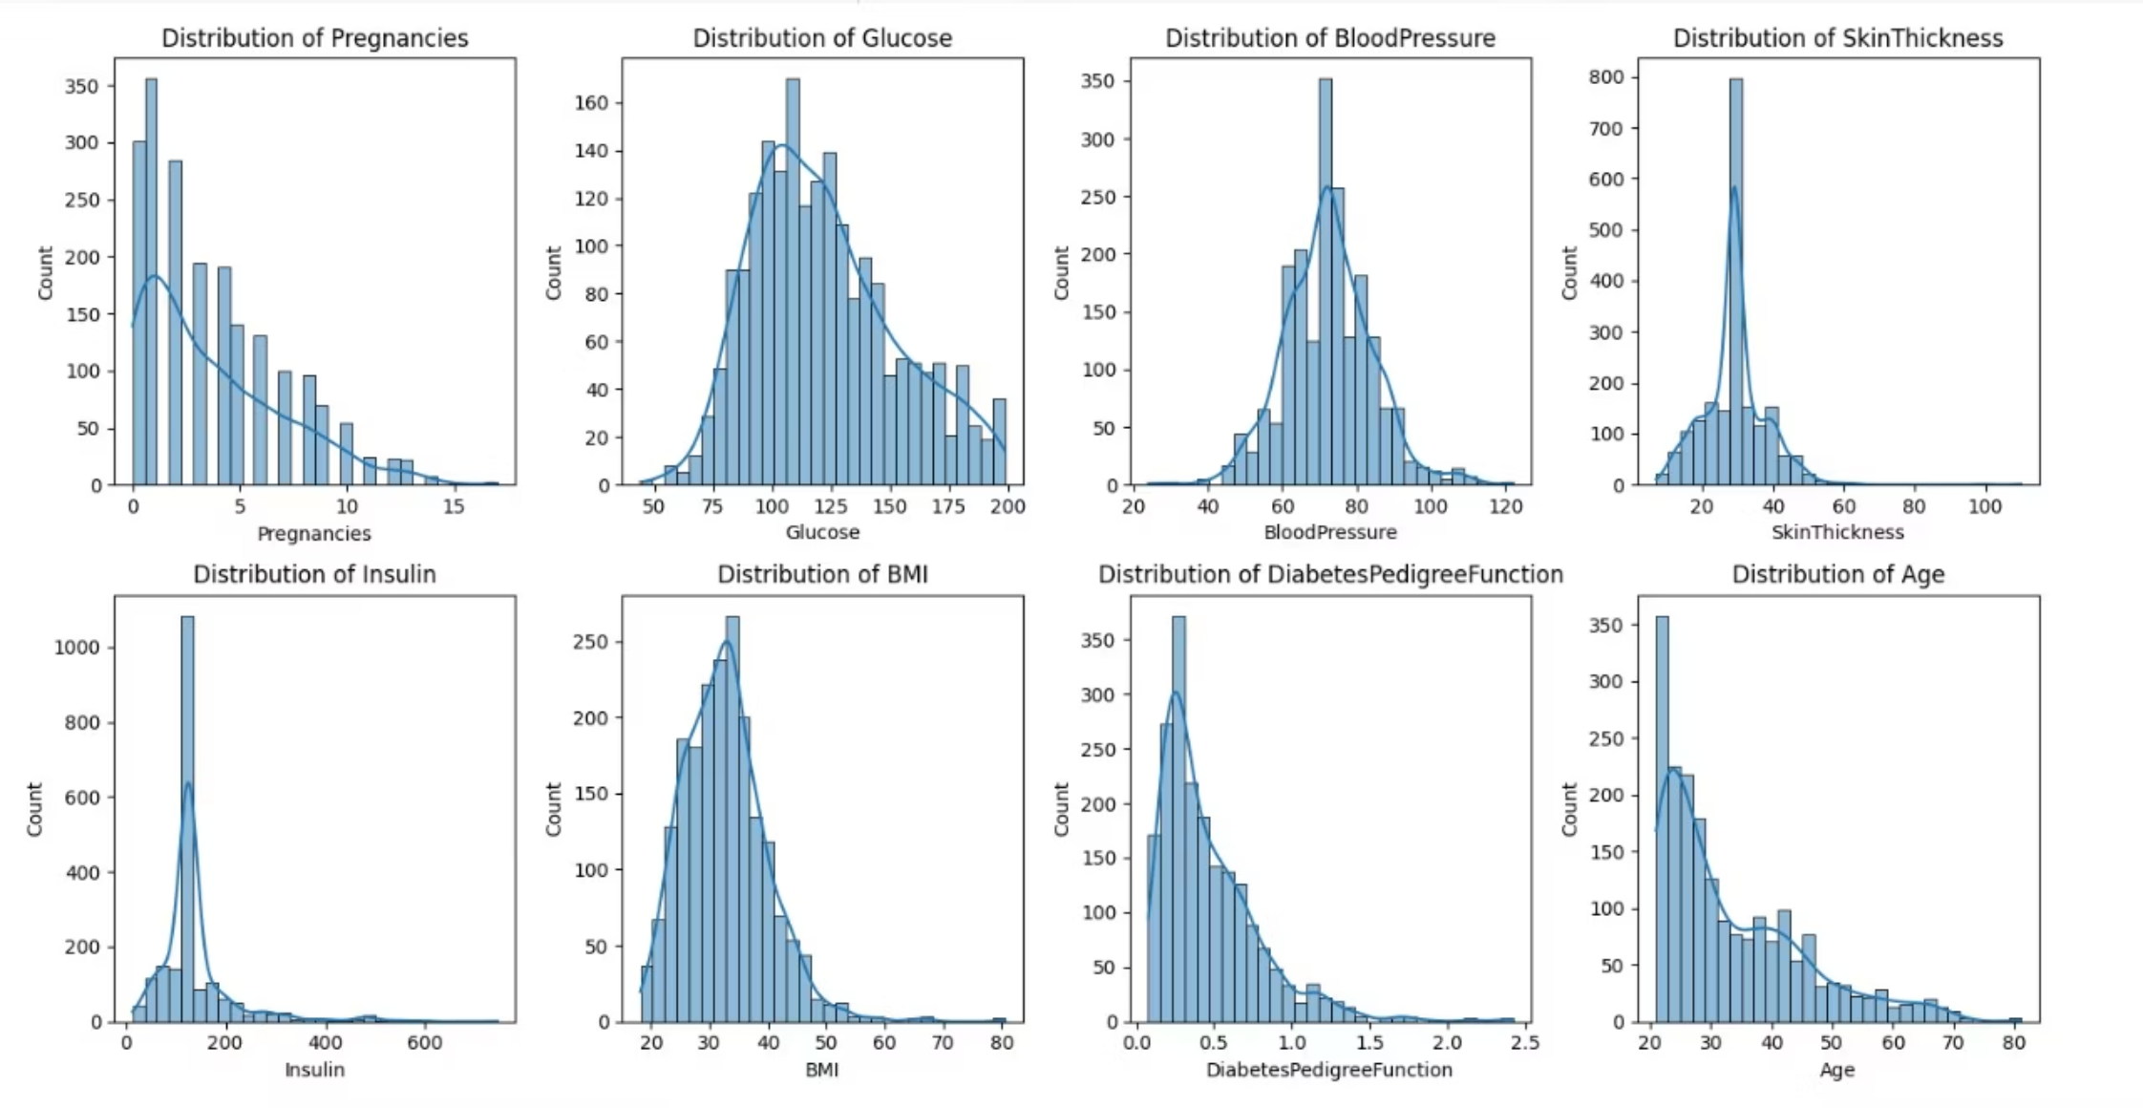
The Core Process
1
Data Understanding & Cleaning
Before any analysis, we ensure the Pima Indians Diabetes Dataset is meticulously prepared. This involves:
Invalid values: Thoroughly checking for and correcting any missing or invalid values.
Outlier Management: Identifying and appropriately handling outliers that could skew the model's accuracy.

Slide 8

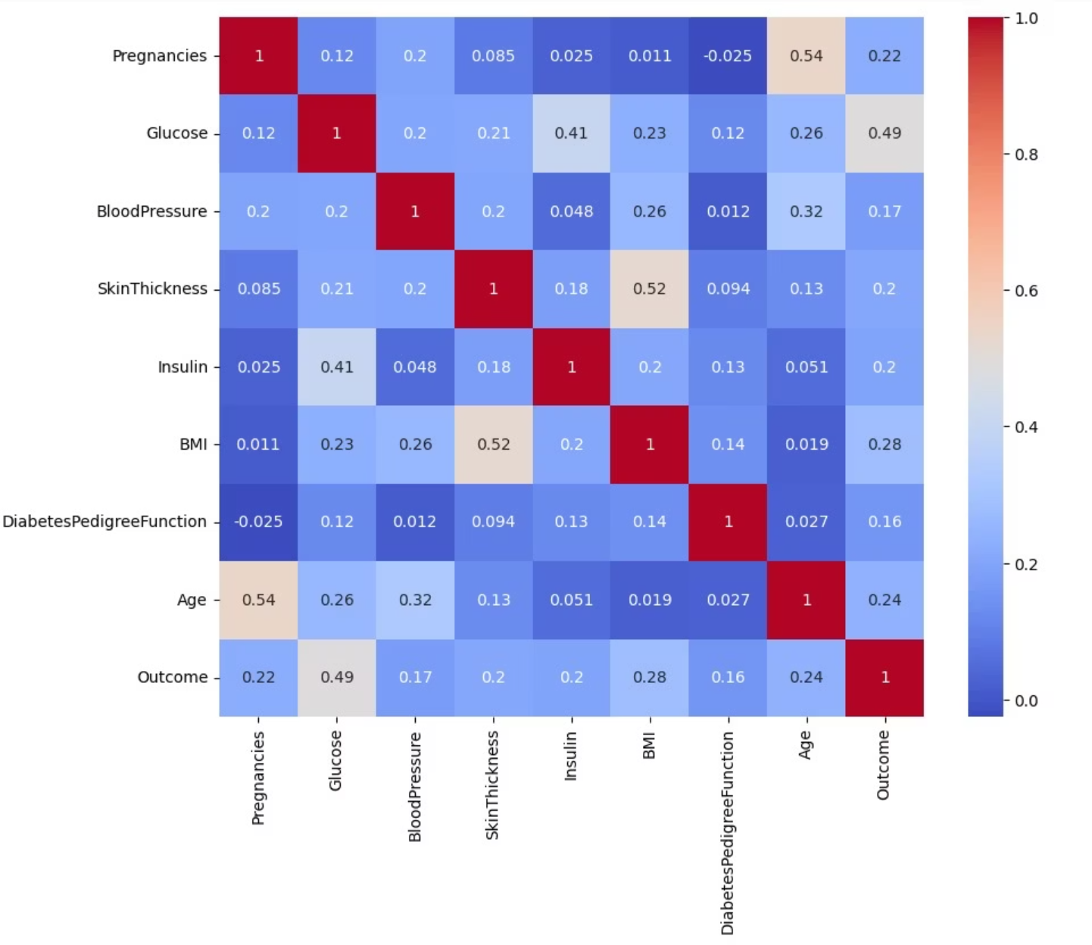
The Core Process
Exploratory Data Analysis (EDA)
Before building any model, we perform Exploratory Data Analysis (EDA) to understand the dataset. This involves examining distributions, detecting patterns, and identifying outliers.
Visualized distributions (boxplots, histograms) .
Checked correlation between features and outcome .
Correlation heatmap.

Slide 9

The Core Process
Feature Scaling/Selection
Before training the model, we apply Feature Scaling and Selection. This helps ensure all features contribute fairly and improves the model’s performance by removing irrelevant or redundant data.
Standardized numeric features .

Slide 10

The Core Process
Model Preparation
We finalize the feature set and target, encode and scale variables, handle class imbalance, split the data into train/validation/test.
Data splitting for model evaluation .
Data splitting into features (X) and labels/target (y).

Slide 11

The Core Process
Model Building
we select appropriate algorithms, train the model using the prepared dataset, and fine-tune its parameters to achieve optimal performance.
Tried multiple models (Logistic Regression, Random Forest, XGBoost).
Tuned hyperparameters for Random Forest model to improve performance.

Slide 12

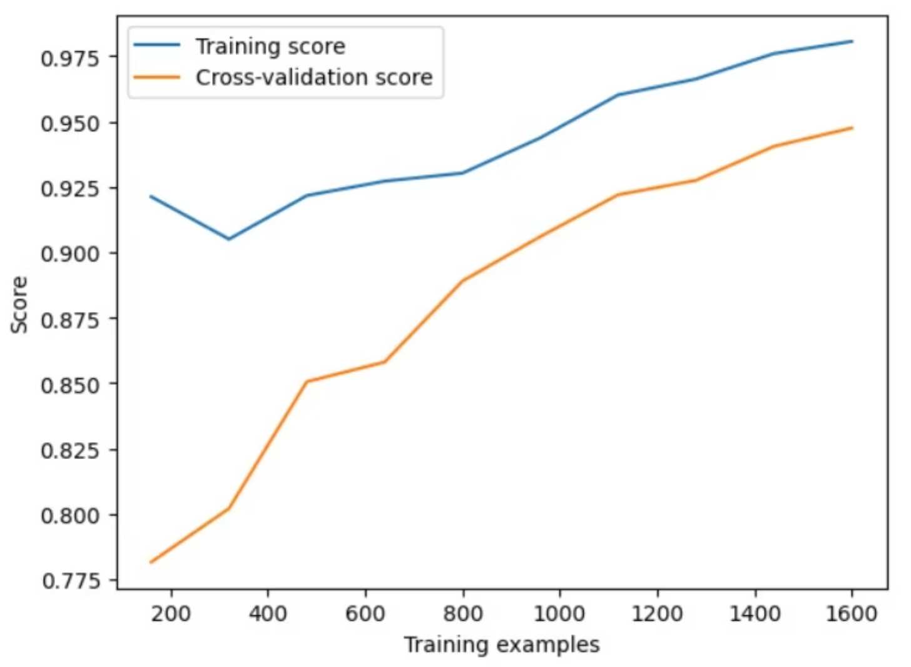
The Core Process
Model Evaluation
During Model Evaluation, we assess the trained model's performance using metrics such as accuracy, precision, recall, and F1-score to ensure it makes reliable predictions.
Compared accuracy, precision, recall, and F1-score.
A learning curve helps track a model’s progress during training.

Slide 13
Model Performance Results
After rigorous testing and fine-tuning, our predictive model demonstrates exceptional performance in identifying diabetes risk. We are proud to present the key outcomes:
Best Performing Model
High Accuracy Achieved
Balanced Prediction Metrics
The Random Forest Classifier emerged as the superior choice due to its robustness and ability to handle complex datasets, providing reliable predictions for diabetes risk.
Our model consistently achieved an impressive accuracy rate of approximately 90-95%, ensuring a high degree of confidence in its assessments.
Beyond accuracy, the model demonstrates a good balance between sensitivity and specificity, minimizing both false positives and false negatives, which is crucial for health risk assessment.

Slide 14




The Impact of Our Predictive Model
Our machine learning model is not just a technological achievement; it's a powerful tool designed to revolutionize early diabetes risk assessment and empower individuals in their health journeys.
Predictive Insights
Clinical Support
Proactive Health
Leverages advanced algorithms to accurately predict diabetes risk, identifying potential issues before symptoms appear.
Provides doctors with a valuable supplementary tool for early diagnosis, streamlining the detection process.
Empowers individuals to take preventive actions sooner, potentially delaying or preventing the onset of diabetes.
Important Disclaimer: This app provides a relative risk assessment and is not a substitute for professional medical advice. Always consult a healthcare provider for a definitive diagnosis and treatment plan.

